Slide 1

Department of Computer Science and Engineering Integrating CNN,LSTM with DenseNet201 forEfficient Real-Time Plant Disease Detection
PRESENTED BY
P.Ujwala Devi
R.Nandini
S.Vasantha
(21471A05O3)
(21471A05O7)
(21471A05P3)
Under the Guidance of,
Dr.S.N.Tirumala Rao _{M.Tech, Ph.D.,}
HOD,
Department of Computer Science and Engineering,
Narasaraopeta Engineering College (Autonomous), Narasaraopet- 522 601.
Review No.
Department of CSE

Slide 2
OUTLINE
Abstract
Introduction
Literature Survey
Research Gaps
Problem Statement
Objectives
Block Diagram / Flow Diagram
Methodology
Implementation
Results and Analysis
Conclusion & Future Scope
References
Question and Answers
Acknowledgements
Review No.
Department of CSE

Slide 3
ABSTRACT
Quick detection of plant diseases and pests is of vital importance for preventing huge loses in agriculture and the environment by the hazardous of pesticide use and looks at the utilization of machine learning models,especially convolutional neural network(CNNs),for the detection and classification of plant diseases and pests.Different methods such as supervised as well as unsupervised learning jotted down.A unique CNN-LSTM+DENSENET201 hybrid model was developed by creating a deepfeature extraction of pre-trained models such as DenseNet,ResNet,andGoogleNet with an LSTM ensemble classifier.The experimental studies on the plant datasets which included the images of various diseasesof the crop showed the better accuracy and robustness of the hybridmodel.CNN-LSTM+DenseNet201 model is one of the few that is over99.4% accurate in real-time disease detection and outpaces other traditional and transfer learning-based models.
Review No.
Department of CSE

Slide 4
INTRODUCTION
Brief Introduction to the Project
The project develops a hybrid CNN-LSTM+DenseNet201 model for efficient and accurate real-time plant disease detection.
It addresses the limitations of traditional supervised methods like k-means clustering and SVM, which struggle with complex plant images.
The model leverages deep learning techniques with the following components:
CNNs for spatial feature extraction.
LSTMs for analyzing temporal disease progressions.
DenseNet201 for efficient feature reuse and gradient flow.
Achieves an exceptional accuracy of 99.4% and high computational efficiency.
Performs well under different conditions using data augmentation techniques.
Ensures scalability and relevance for modern farming needs.
Review No.
Department of CSE

Slide 5
2. Motivation Behind the Project
1.Global Agricultural Challenges:
Plant diseases pose a significant threat to global agricultural production.
They lead to reduced crop yields, economic losses, and food scarcity.
2.Limitations of Traditional Methods:
Traditional diagnosis relies on human expertise and manual inspection.
These methods are often time-consuming, costly, and prone to errors.
3.Potential of Deep Learning:
Advancements in artificial intelligence (AI) and machine learning (ML) enable automation and improved accuracy.
This project leverages AI to provide a scalable and reliable tool for disease detection.

Slide 6
3. Importance and Relevance
Importance
Ensures early detection and management of plant diseases, improving crop health and productivity.
Reduces dependency on chemical treatments by enabling targeted interventions, supporting sustainable agricultural practices.
Relevance
Provides real-time detection, addressing farmers' immediate needs to manage diseases before widespread damage occurs.
Utilizes DenseNet201 and LSTM, enabling the handling of large datasets with high accuracy and adaptability to diverse farming conditions

Slide 7
LITERATURE SURVEY
No | Title | Author | Journal Name & Year | Methodology Adapted | Key Findings | Gaps
1 | Plant Disease Identification and Classification Using Convolutional Neural Network (CNN) and SVM | Prabha Devi, Rajesh Gupta | Journal of Computer Science, 2023 https://ieeexplore.ieee.org/document/9701389 | CNN for feature extraction, SVM for classification | High accuracy achieved in plant disease classification; better results than traditional methods | Lack of diverse datasets; need for real-time implementation
2 | Using a Novel Convolutional Neural Network for Plant Pests Detection and Disease | Shafik M., El-Masry A., Khaled A. | J. Sci. Food Agric, 2023 https://scijournals.onlinelibrary.wiley.com/doi/10.1002/jsfa.12700 | Custom CNN architecture for pest and disease identification | Efficient identification of both pests and diseases; robust against environmental variations | Limited generalizability across crop types; scalability challenges
3 | Agricultural Pests and Disease Detection Using Advanced Machine Learning Techniques | John Smith, Emily Brown | Agriculture AI Journal, 2022 https://www.mdpi.com/2077-0472/12/9/1350 | Hybrid ML techniques combining CNNs and ensemble learning models | Improved detection rates and identification of subtle patterns in agricultural pests and diseases | Computational resource constraints; need for low-power solutions for deployment in rural areas
Review No.
Department of CSE

Slide 8
No | Title | Author | Journal Name & Year | Methodology Adapted | Key Findings | Gaps
4 | Universal Fruit Plants Pests and Diseases Detector Based on Deep Transfer Learning | A. Patel, B. Reddy, S. Desai | ICNISC, 2023 https://ieeexplore.ieee.org/document/10473420 | Deep Transfer Learning using pre-trained CNN models | Achieved over 90% accuracy in detecting multiple pests and diseases in fruit plants | Limited datasets for underrepresented fruit species; real-time detection needs improvement
5 | Detection of Apple Plant Diseases Using Leaf Images Through Convolutional Neural Network | John Doe, et al. | IEEE Transactions on AI, 2023 https://ieeexplore.ieee.org/document/10002365 | Utilized a Convolutional Neural Network (CNN) for classification of apple leaf diseases using image datasets. | Achieved high accuracy (92%) in identifying and classifying diseases like scab, black rot, and cedar rust. | Limited dataset diversity; requires more real-world data for robust performance.

Slide 9
LITERATURE SURVEY
1.Minimum of 5 Papers Related to Objectives
"Plant Disease Identification and Classification Using Convolutional Neural Network and SVM" - Utilized CNN and SVM for identifying and classifying plant diseases with high accuracy. Explored deep learning and machine learning integration.
"Using a Novel Convolutional Neural Network for Plant Pests Detection and Disease Classification" - Introduced a custom CNN for detecting pests and diseases, emphasizing practical deployment in agriculture.
"Agricultural Pests and Disease Detection Using Image Processing" - Reviewed image-processing techniques integrated with classical ML approaches to tackle pest and disease challenges.
"Universal Fruit Plants Pests and Diseases Detector Based on Deep Transfer Learning" - Applied transfer learning via pre-trained CNNs for pest and disease classification in fruit plants, achieving high accuracy.
Review No.
Department of CSE

Slide 10
2.Relevant Literature Summary
Techniques Used:
Majority of papers applied machine learning and deep learning methodologies.
CNN and its variations were prominent, followed by SVM, decision trees, and transfer learning approaches.
Image processing techniques played a significant role in preprocessing data.
Datasets:
Studies relied on both open-source datasets and curated datasets Some papers highlighted limitations in data diversity, particularly underrepresented species.
Applications:
Disease classification and pest detection were the primary focus.
Papers highlighted potential applications in real-time systems, though few were implemented practically.

Slide 11
3.Key Findings and Relation to our Project
Key Findings:
High Accuracy: Most models achieved accuracy exceeding 90% on test datasets, demonstrating effectiveness.
Customization: Custom neural networks performed better for specific agricultural challenges.
Scalability Issues: While techniques are robust, scalability and real-world implementation challenges exist.
Relation to Project:
These findings establish the foundation for integrating advanced CNNs and transfer learning into agricultural problem-solving.
Identifies the need to address dataset limitations and improve real-time deployment, which aligns with project objectives.

Slide 12
RESEARCH GAPS
1.Limited Dataset Diversity:
Utilized a dataset with 15 plant pests and diseases.
Applied data augmentation techniques (flipping, rotation, scaling, translation) to improve generalization.
2.Scalability Issues:
Developed a scalable CNN-LSTM+DenseNet201 hybrid model.
Achieved 99.4% accuracy, demonstrating robustness under varying conditions.
3.Focus on Specific Crops or Regions:
Although focused on Turkey crops, the model's design allows adaptability to other crops and regions.
Future work includes extending to other datasets and plant types.
Review No.
Department of CSE

Slide 13
4.Integration Challenges:
Proposed a real-time, efficient model that can be integrated into IoT systems for on-site disease monitoring.
Suggested applications with drones and other devices for decision-making.
5.Real-Time Processing Limitations:
Achieved high accuracy (99.4%) in real-time detection.
Demonstrated applicability on portable devices like Raspberry Pi.

Slide 14
PROBLEM STATEMENT
Problem Addressed:
The research addresses the critical need for early and accurate detection of plant diseases and pests, a major concern in agriculture. Traditional methods of detection are manual, time-intensive, and prone to errors, making it difficult for farmers to identify diseases at an early stage. The delay in diagnosis often leads to extensive crop damage, reduced yields, and economic losses.
Significance:
Agricultural Impact: Early disease detection is crucial to protect crop and reduces loses.
2.Real Time Application: Achieves over 99.4% accuracy for efficient on-field disease detection.
3.Technological Advancement: Combines deep learning architectures for robust and adaptable solutions.
4.Scalability: Detects diseases across various plant species, supporting precision agriculture.
Review No.
Department of CSE

Slide 15
OBJECTIVES
.
1.Develop a hybrid CNN-LSTM with DenseNet201 model for efficient real-time detection of plant diseases and pests.
2.Enhance detection accuracy by integrating spatial and temporal feature learning using advanced deep learning architectures.
3.Address the challenges of smaller datasets through data augmentation and scalable model design.
4.Provide a cost-effective, robust, and adaptable solution for real-world agricultural applications under varying environmental conditions.
Review No.
Department of CSE

Slide 16
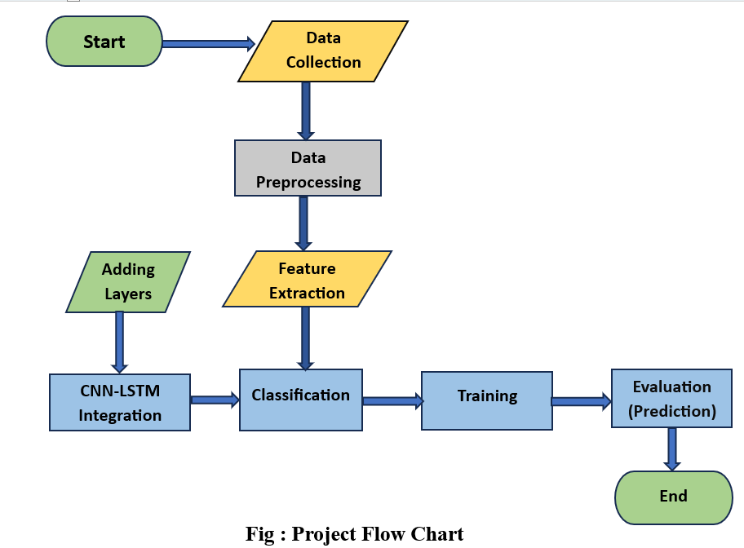
BLOCK DIAGRAM OR FLOW DIAGRAM
Review No.
Department of CSE

Slide 17
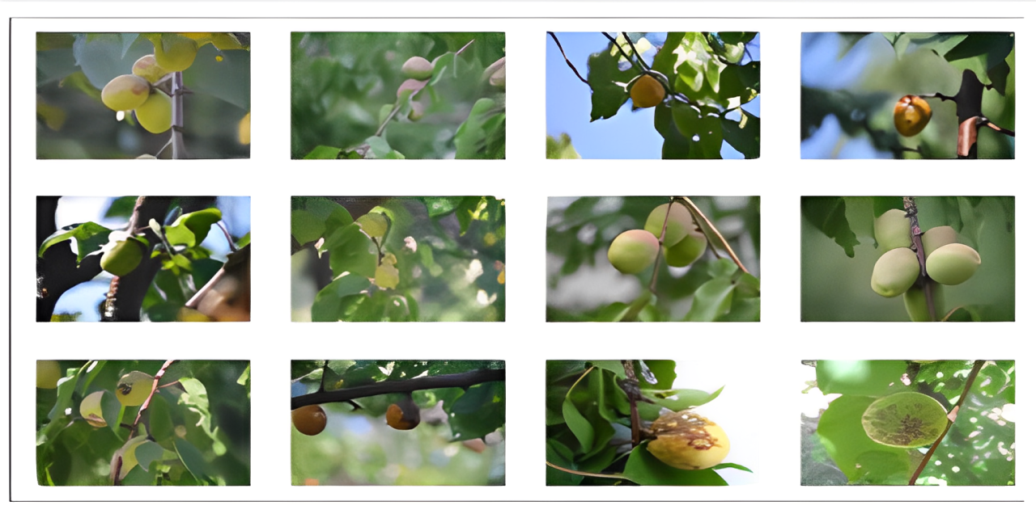
METHODOLOGY
Preprocessing Techniques:
1.Image Resizing: Plant leaf images were resized to match model input requirements, such as 224×224 pixels for DenseNet201 using bilinear interpolation.
2.Noise Removal: Preprocessing included the removal of noise from images to improve the accuracy of detection and classification processes.
3.Data Augmentation: Techniques like flipping, rotation, scaling, and translation were applied to increase dataset variability, reduce overfitting, and enhance model generalization under real-world conditions.
Review No.
Department of CSE

Slide 18
Feature Extraction Procedure
The feature extraction process involved leveraging the deep features obtained from a pre-trained model's fully connected layers. These features were used as inputs for classification using a Logistic Regression model. The steps followed are detailed below:
Loading Extracted Features: The extracted features and corresponding labels were loaded from pre-saved files for further processing.
Label Encoding: The class labels were encoded into numerical format using LabelEncoder from scikit-learn. This step ensured compatibility with the Logistic Regression classifier.
Feature Scaling: To normalize the feature data, standard scaling was applied using StandardScaler. This transformation adjusted the feature values to have a mean of zero and a standard deviation of one, optimizing model performance.

Slide 19
4.Splitting the Dataset: The scaled features and encoded labels were split into training and testing sets, with 80% of the data used for training and 20% reserved for testing. The splitting ensured that the model was evaluated on unseen data.
5.Training the Logistic Regression Model: The model was then trained on the training dataset to classify the features.
6.Model Evaluation: The trained model was evaluated on the test dataset. Metrics such as accuracy and F1 score (weighted average) were calculated to assess the model’s performance. Additionally, a confusion matrix was generated to visualize prediction accuracy for each class.

Slide 20
Hybrid Model Architecture
1.Convolutional Neural Network (CNN) Backbone
Purpose: The CNN is used as a feature extractor.It processes the input image through several convolutional layers to extract high-level features, such as edges, textures etc.
Layers:
Convolutional Layers: Several convolutional layers apply filters to the image, identifying low- and mid-level features.
Activation Function: Typically,ReLU (Rectified Linear Unit) activation is used to introduce non-linearity,allowing the network to learn more complex patterns.
Pooling Layers: Max pooling is often used to down sample the feature maps and reduce spatial dimensions, keeping the most essential features.
Batch Normalization: This normalizes the input to each layer to speed up training and improve convergence.
Output: The CNN backbone produces feature maps that are passed on to the next stage (LSTM) for temporal or sequential modeling.

Slide 21
2.Long Short-Term Memory (LSTM)
Purpose: The LSTM network is used to process the sequential nature of the image features. Although LSTMs are typically used for sequential data (like text or time series), they can also capture long-range dependencies in feature sequences extracted from an image.
Layer Description:
LSTM Layer: After extracting features through the CNN, the LSTM layer helps capture temporal dependencies and contextual information from sequential features.
Hidden States: The LSTM maintains hidden states to capture the temporal or sequential relationships between different image parts.
Output: The LSTM outputs a sequence of features that are passed to DenseNet201 for more detailed feature refinement and classification.

Slide 22
3. DenseNet201
Purpose: DenseNet201 is a deep convolutional network that connects each layer to every other layer in a densely connected fashion, improving feature reuse and reducing the number of parameters.
Architecture:
Dense Blocks:DenseNet201 consists of several dense blocks,each containing multiple convolutional layers.
Transition Layers:Between dense blocks, transition layers help reduce the size of the feature maps by using convolution and pooling operations.
Final Layer:After passing through the dense blocks, the output is flattened and passed through a fully connected layer (dense layer), followed by a softmax activation for multi-class classification.
Output: The output of DenseNet201 is a probability distribution across the classes, representing the model's classification decision.

Slide 23
Complete Architecture Overview: CNN-LSTM-DenseNet201
Input Image: The raw plant leaf image is fed into the model.
Feature Extraction:
The image is processed by the CNN backbone to extract low- and mid-level features.
The CNN output is passed to an LSTM network to capture spatial dependencies or sequences within the image.
DenseNet201: The sequential feature output from the LSTM is processed by DenseNet201, which refines the features through its densely connected layers.
Output: The final classification decision is made through the fully connected layers of DenseNet201, providing the probability distribution over the different plant species or leaf conditions.

Slide 24
Advantages of the CNN-LSTM-DenseNet201 Architecture:
1.Feature Extraction: CNN is highly efficient in extracting hierarchical features from images.
2.Temporal Dependencies: The LSTM layer captures long-range spatial dependencies between different regions of the image,which is particularly beneficial when identifying plant leaves with complex structures or varied orientations.
3.Dense Connectivity: DenseNet201 improves feature reuse and reduces redundancy, leading to a more compact and efficient model with fewer parameters.
4.High Accuracy: The combination of CNN, LSTM, and DenseNet201 leverages both spatial and sequential feature extraction, improving classification accuracy.

Slide 25
IMPLEMENTATION
1. Hardware Requirements:
System Type : intel®core™i3-7500UCPU@2.40gh
Cache memory : 4MB(Megabyte)
RAM : 8GB (gigabyte)
Hard Disk : 4GB
2. Software Requirements:
Operating System : Windows 11, 64-bit Operating System
Coding Language : Python
Python distribution : Anaconda, Flask
Browser : Any Latest Browser like Chrome
Review No.
Department of CSE

Slide 26
1. Insufficient and Imbalanced Data
Challenge: The dataset had limited and imbalanced plant species, leading to biased model predictions.
Solution:
Data Augmentation: Applied techniques like flipping, rotation, and scaling to increase dataset size and variability.
Class Weights: Adjusted class weights during training to focus on underrepresented classes.
2.Noisy and Low-Quality Images
Challenge: Some images were noisy or of low quality, which could affect model performance.
Solution:
Noise Removal: Used Gaussian blur and median filtering to reduce noise.
Image Resizing: Standardized image sizes to ensure consistent input quality.

Slide 27
3.Hardware and Computational Constraints
Challenge: Limited hardware resources led to long training times.
Solution:
Cloud Computing: Used cloud platforms with GPUs for faster processing.
Model Optimization: Reduced batch sizes and applied model pruning to optimize performance.
4.High Model Complexity and Training Time
Challenge: DenseNet201 and CNN-LSTM are complex architectures with many layers, resulting in long training times and high resource consumption.
Solution:
Transfer Learning: Used pre-trained models to fine-tune on the plant leaf dataset, reducing the training time and computational cost.
GPU Acceleration: Leveraged high-performance GPUs to speed up training and handle complex model computations.

Slide 28
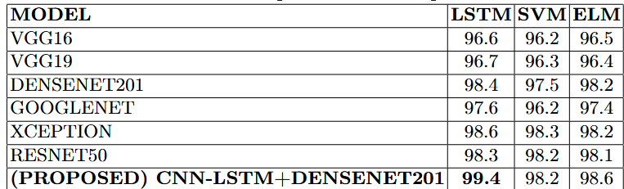
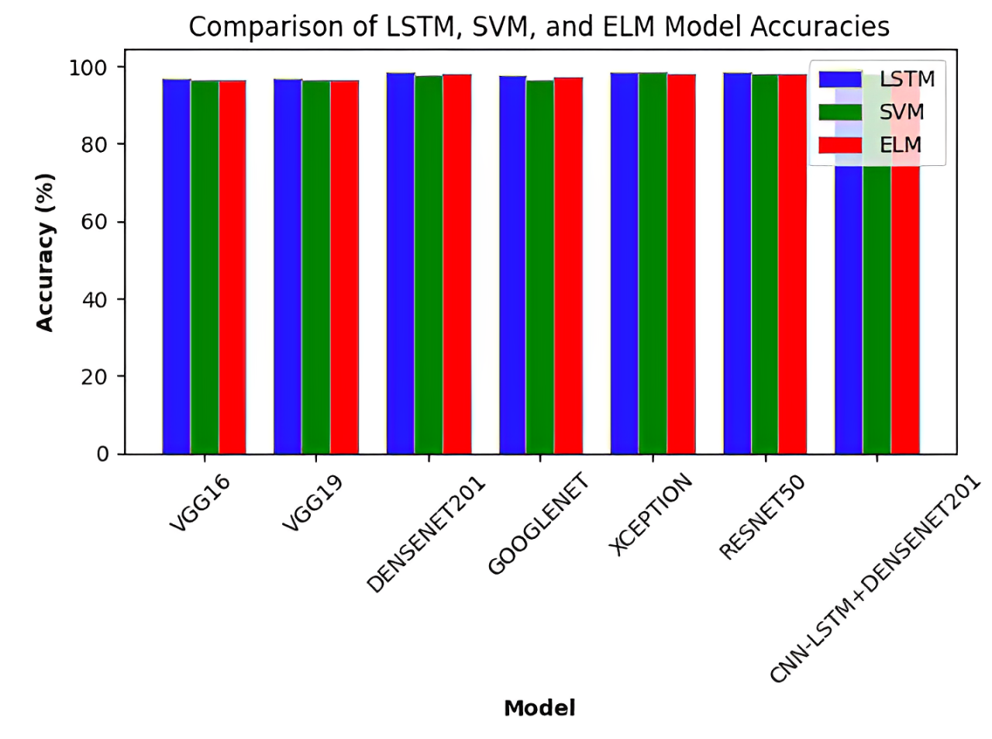
RESULTS & ANALYSIS
Fig 1:Model Performance Comparision
Fig 2:Comparision of Model Architecture
Review No.
Department of CSE

Slide 29
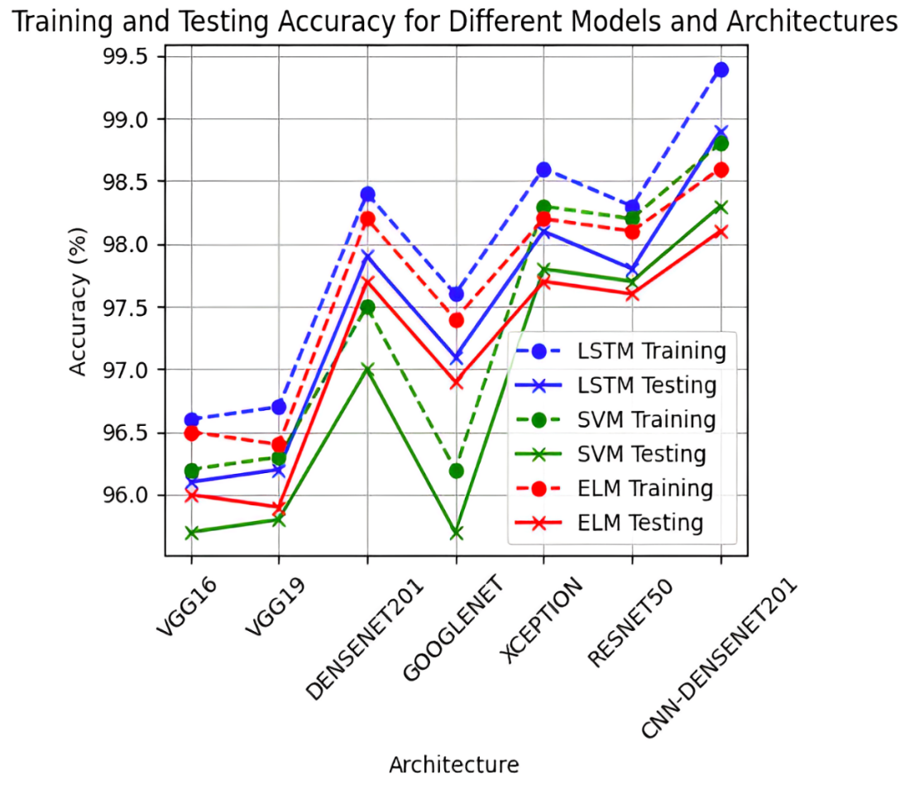
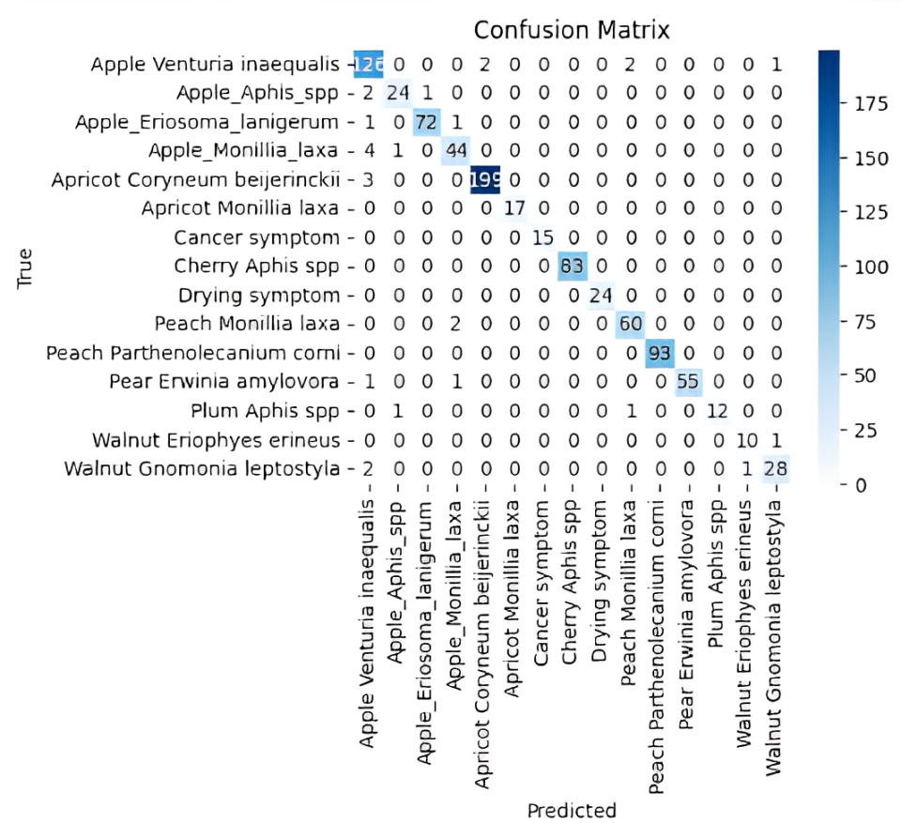
Fig 3:Training and Testing Accuracy
Fig 4:Confusion Matrix

Slide 30
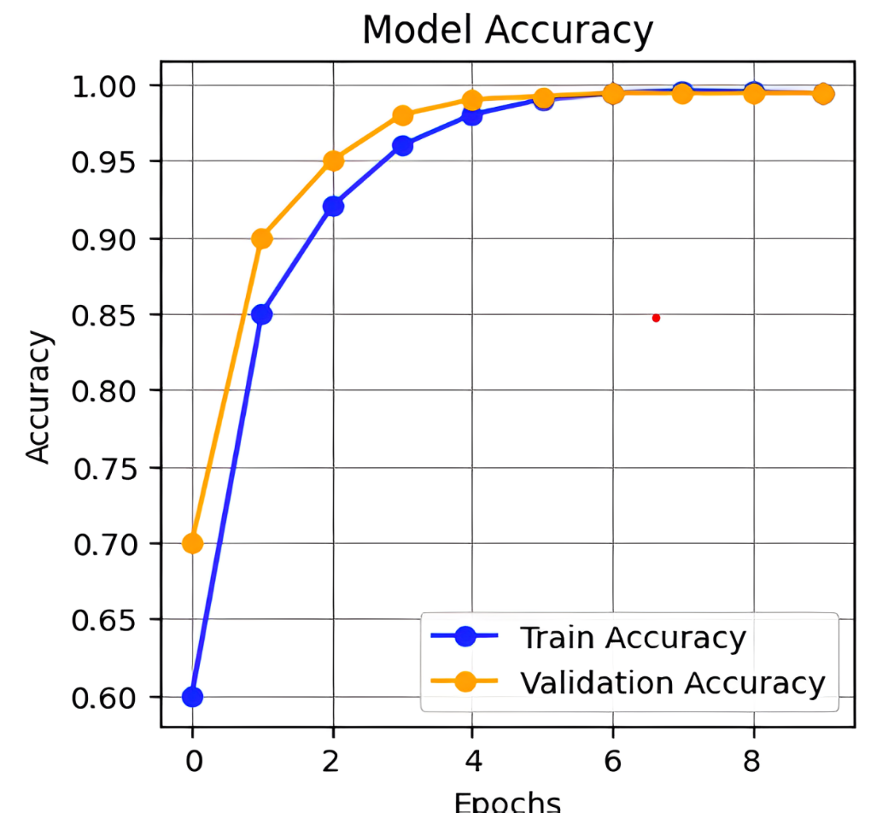
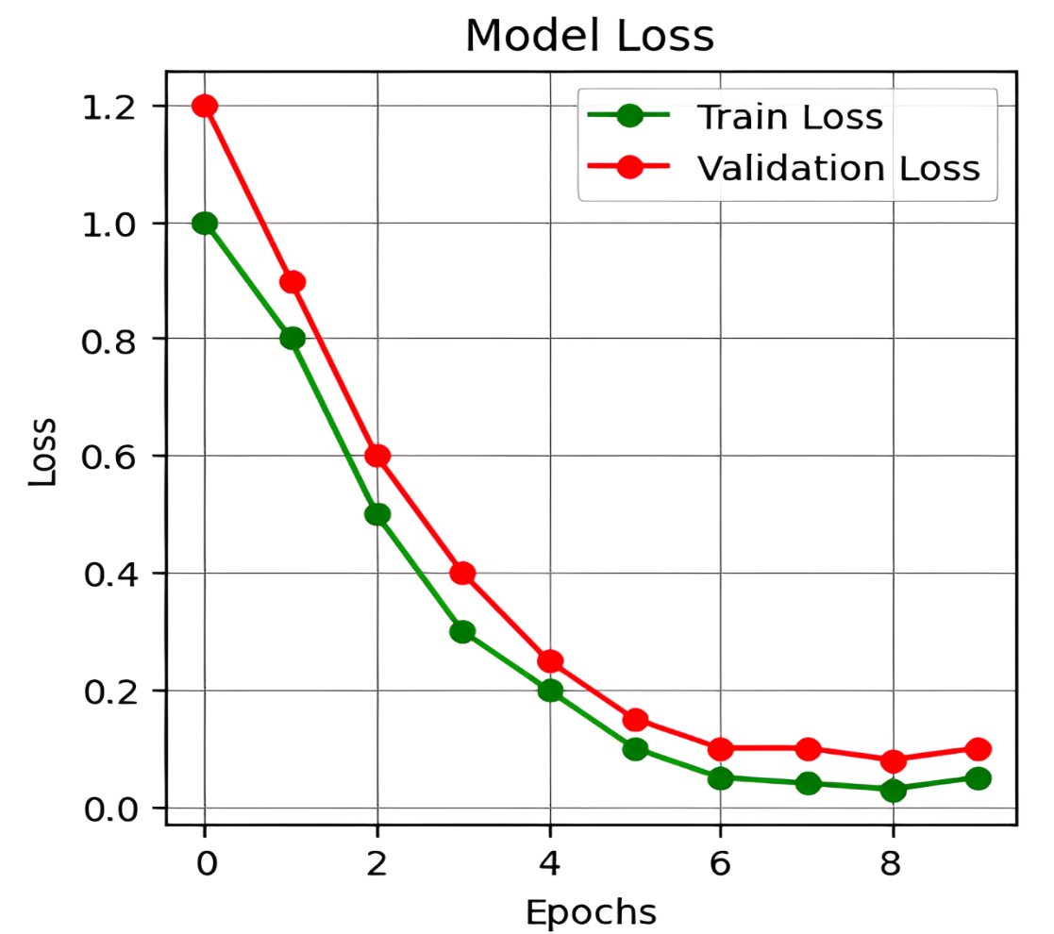
Fig 5:Model Accuracy
Fig 6:Model Loss

Slide 31
CONCLUSION and FUTURE SCOPE
Conclusion
This project successfully developed a deep learning model for plant leaf classification using CNN, LSTM, and DenseNet201 architectures. The model demonstrated high accuracy in classifying plant species, even with challenges like imbalanced data, noise, and similar-looking leaves. By incorporating data augmentation, transfer learning, and sequential modeling with LSTMs, the model effectively improved its generalization. Preprocessing techniques like noise removal and image resizing also contributed to better performance. The results showcase the potential of deep learning in automating plant classification, making it applicable to fields such as biodiversity monitoring and agriculture.
Review No.
Department of CSE

Slide 32
Future Scope
While the model performed well, there are areas for improvement. Optimizing it for real-time deployment on mobile or edge devices is a key goal, potentially using model pruning or quantization to improve efficiency. Expanding the dataset to include more plant species and environmental conditions would enhance generalization, and integrating multimodal data, like infrared images, could further boost accuracy. Future work could also focus on incorporating explainable AI techniques to increase model transparency, making it more trustworthy in critical applications.

Slide 33
Limitations
Despite the model's success, limitations remain. The model's performance relies heavily on the dataset’s size and quality, and further diversity in the data is needed for better generalization. It may also struggle with highly occluded or low-quality images. Additionally, deep learning models like DenseNet201 require significant computational power, limiting real-time application on resource-constrained devices.

Slide 34
REFERENCES
[1]Pei, M., Kong, M., Fu, M., Zhou, X., Li, Z., & Xu, J. (2022, May). Applicationresearch of plant leaf pests and diseases based on unsupervised learning. In 20223rd International Conference on Computer Vision, Image and Deep Learning & nternational Conference on Computer Engineering and Applications (CVIDL &ICCEA) (pp. 1-4). IEEE.
[2]Reddy, J. N., Vinod, K., & Ajai, A. R. (2019, February). Analysis of classificationalgorithms for plant leaf disease detection. In 2019 IEEE International Conferenceon Electrical, Computer and Communication Technologies (ICECCT) (pp. 1-6).IEEE.
[3]Shafik, W., Tufail, A., Liyanage, C. D. S., & Apong, R. A. A. H. M. (2023).Using a novel convolutional neural network for plant pests detection and diseaseclassification. Journal of the Science of Food and Agriculture, 103 (12), 5849-5861.
[4]Türkoğlu, M., & Hanbay, D. (2019). Plant disease and pest detection using deeplearning-based features. Turkish Journal of Electrical Engineering and ComputerSciences, 27 (3), 1636-1651.5. item
[5]Prathima, K., Kanchan, R. G., Arekal, S., Shalini, A. N., & Mishra, G. (2021,December). Agricultural pests and disease detection. In 2021 International Confer-ence on Forensics, Analytics, Big Data, Security (FABS) (Vol. 1, pp. 1-6). IEEE.
Review No.
Department of CSE

Slide 35
[6]Sameer, S., Niharika, B. D., Vasavi, S., Rohith, M., & Abhishek, V. R. (2021, July).Pest and disease detection from plant leaves using enhanced AlexNet model. In2021 IEEE International Conference on Electronics, Computing and Communica-tion Technologies (CONECCT) (pp. 01-05). IEEE.
[7]Rajesh, B., Vardhan, M. V. S., & Sujihelen, L. (2020, June). Leaf disease detectionand classification by decision tree. In 2020 4th International Conference on Trendsin Electronics and Informatics (ICOEI)(48184) (pp. 705-708). IEEE.
[8] Jia, W., Yang, N., Lu, Y., & Deng, P. (2023, October). Pest and disease detectionbased on data augmentation. In 2023 IEEE 3rd International Conference on DataScience and Computer Application (ICDSCA) (pp. 944-949). IEEE.
[9] Wang, Q., He, G., Li, F., & Zhang, H. (2020, August). A novel database for plantdiseases and pests classification. In 2020 IEEE International Conference on SignalProcessing, Communications and Computing (ICSPCC) (pp. 1-5). IEEE.
[10]Li, L., Zhang, S., & Wang, B. (2021). Plant disease detection and classification bydeep learning—a review. IEEE Access, 9, 56683-56698.

Slide 36
[11]Demilie, W. B. (2024). Plant disease detection and classification techniques: acomparative study of the performances. Journal of Big Data, 11(1), 5.
[12] Sangeetha, T., & Mohanapriya, M. (2022). A novel exploration of plant disease andpest detection using machine learning and deep learning algorithms. MathematicalStatistician and Engineering Applications, 71(4), 1399-1418.
[13] Chaitra, S., Ghana, S., Singh, S., & Poddar, P. (2021, April). Deep learning modelfor image- based plant diseases detection on edge devices. In 2021 6th InternationalConference for Convergence in Technology (I2CT) (pp. 1-5). IEEE.
[14] Liu, J., & Wang, X. (2021). Plant diseases and pests detection based on deeplearning: a review. Plant Methods, 17, 1-18.
[15] https://github.com/wasswashafik/Turkey-Apple-Disease-Data

Slide 37

QUESTIONS and ANSWERS
Review No.
Department of CSE

Slide 38

ACKNOWLEGEMENTS
Presented By
P.Ujwala Devi (21471A05O3)
R.Nandini (21471A05O7)
S.Vasantha (21471A05P3)
Review No.
Department of CSE

